Slide 1
SuperDARN Onsite School, Siziwang, PRC, May 25-27, 2024
A tutorial talk for SuperDARN
J. Michael Ruohoniemi and Joseph B. H. Baker
Center for Space Science and Engineering Research
Bradley Department of Electrical and Computer Engineering
Virginia Polytechnic Institute and State University (Virginia Tech)
Blacksburg, Virginia USA

Slide 2
SD Tutorial Talk - Presentation Outline
HF Radar: Probing the Geospace System
SuperDARN: A Brief History
High-latitude SuperDARN: Science Highlights
Mid-latitude SuperDARN: Science Highlights
Summary
References
Quick Start Guide and Resources

Slide 3
HF Radar: Probing the Geospace System

Slide 4
The Geospace System
Figure Credit: J. Grebowsky
Primary drivers for the high latitude ionosphere are the magnetosphere & solar wind
Primary drivers for the low latitude ionosphere are solar heating & neutral processes
Ionosphere is key to coupling of the magnetosphere-ionosphere-thermosphere system

Slide 5
HF Radar: Backscatter Modes
Magnetic-Field Line
½ hop
Ionospheric plasma irregularities
Ionosphere
1 hop
Ground scatter
Rays at HF frequencies refract downward in the ionosphere as they encounter upward gradients in electron density, enabling long distance propagation
Transmitted signals can be reflected back to the radar by:
1) Ionospheric plasma irregularities
2) Earth’s surface (‘ground scatter’)
Information about the reflectors is carried in the returned signal, e.g., Doppler velocity.

Slide 6
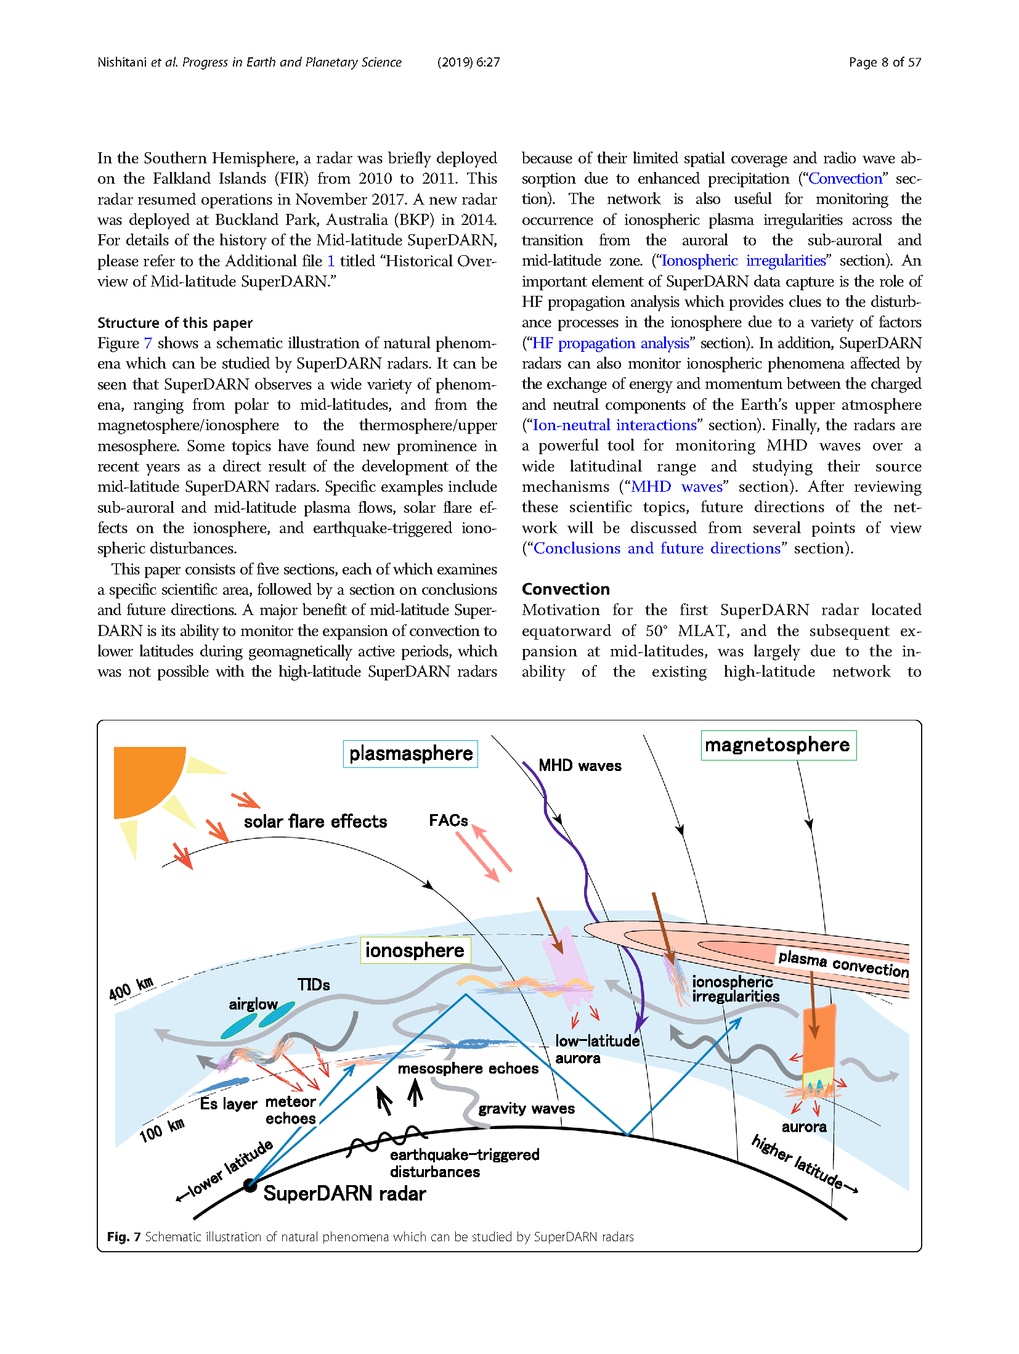
HF Radar: Geospace Targets
[Nishitani et al., 2019]
HF radars provide a bottom-side view of geospace: ionospheric electric fields, plasma irregularities, winds, gravity waves, planetary waves, pulsations, etc.

Slide 7
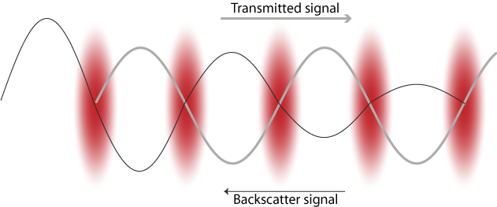
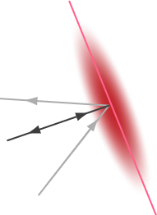
Conditions required to generate coherent backscatter from Field-Aligned density Irregularities (FAIs)
1) Presence of Field-Aligned Irregularities
2) Propagation perpendicular to B
1) Backscatter is amplified under Bragg conditions by density fluctuations with scale sizes on the order of half the transmitted wavelength (tens of meters for HF)
For low-power coherent backscatter the density fluctuations have been amplified above thermal levels by a plasma instability
2) Orthogonality of the transmitted signal with the background magnetic field (aspect condition) provides maximum returned power
Refraction of HF signal enables the required propagation geometry at F region altitudes

Slide 8
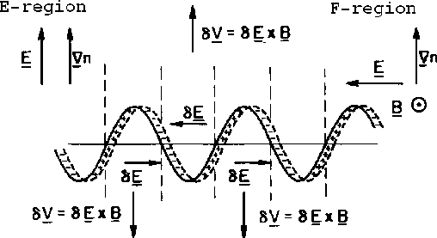
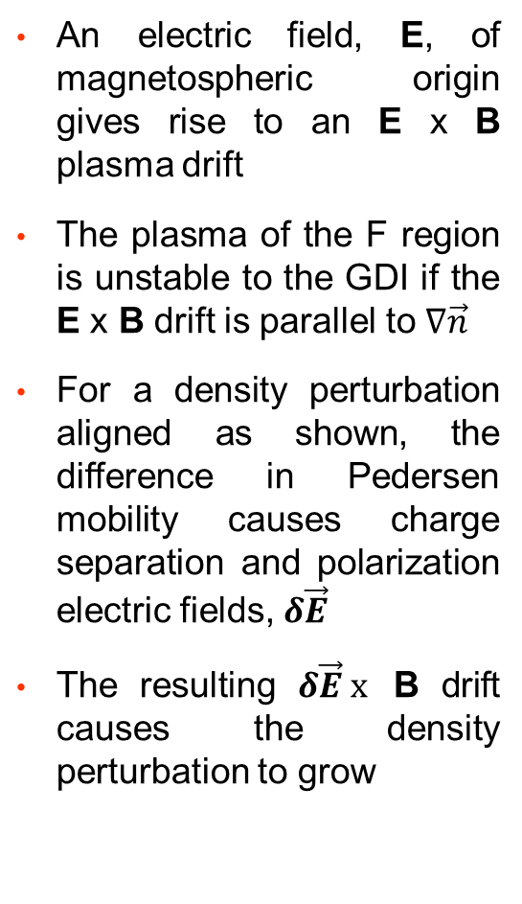
Plasma Instability as a Source of FAIs
An electric field, E, of magnetospheric origin gives rise to an E x B plasma drift
The plasma of the F region is unstable to the GDI if the E x B drift is parallel to $∇\vec{n}$
For a density perturbation aligned as shown, the difference in Pedersen mobility causes charge separation and polarization electric fields, $δ\vec{E}$
The resulting $δ\vec{E} x$ B drift causes the density perturbation to grow
Gradient Drift Instability (GDI)

Slide 9
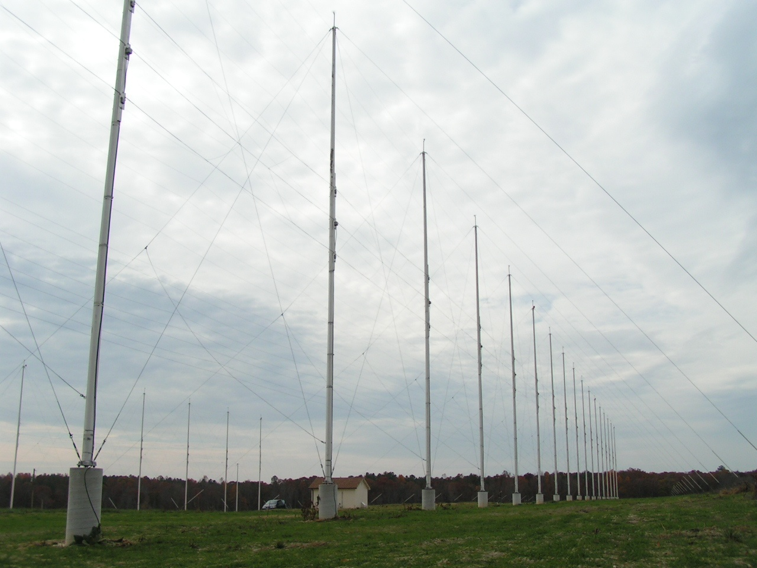
SuperDARN phased-array antenna design
Wire antennas are suspended between 17 m poles.
Guying of the poles and support for the antenna wires are provided by nonmetallic cable.
Each array is equipped with a corner reflector screen mounted on the rear guy lines.
Interferometer Array
Main Array
Site of the SuperDARN radar near Blackstone, Virginia

Slide 10
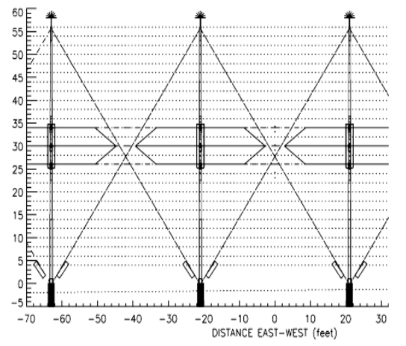
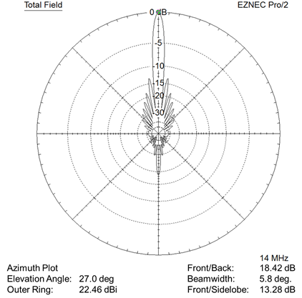
Twin-Terminated Folded Dipole (TTFD) Antenna
Front view showing outlines of TTFD antennas in red
Radiation pattern of a 16-element TTFD array at maximum gain elevation angle
[Sterne et al., 2011]

Slide 11
Transmission of multipulse sequences
Fundamentally, radar Tx / Rx operation consists of transmitting pulses (Tx) and listening for backscatter returns (Rx)
SuperDARN uses a multipulse sequence with irregular spacing to resolve ambiguities due to the overspread nature of FAI backscatter
The backscattered signal is processed for the lags of the autocorrelation function (ACF) from which the signal parameters are determined (power, Doppler velocity, spectral width)
Tx
9
3
8
2
4
1
τ = 2.4 ms
SuperDARN sequence 1995-2002
Sample Pulses
After the initial Tx pulse and a delay, the outputs of the Rx are sampled in a continuous manner as indicated by the sample pulses. Red sample pulses represent the first sample for each of the Tx pulses. During a beam sounding multiple sequences are transmitted and integrated.

Slide 12
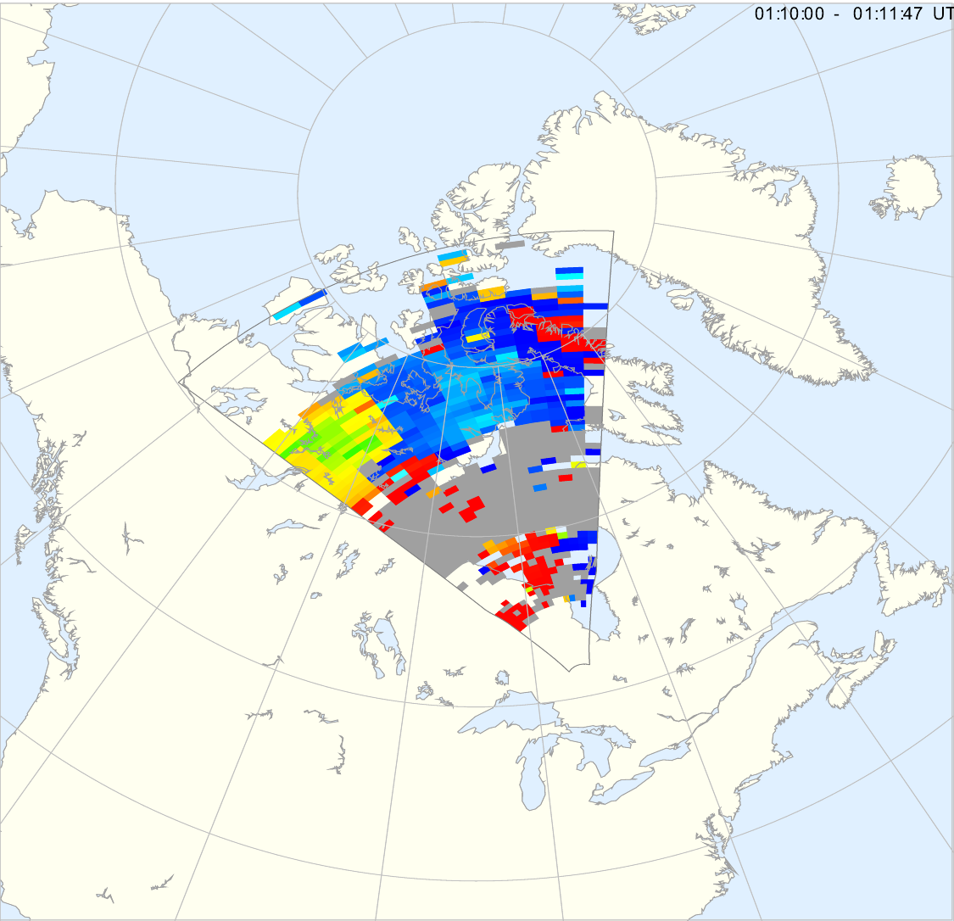
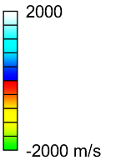
SuperDARN Data: Single Radar Doppler Map
January 11, 2001 01:10:00 – 01:11:47 UT
A radar scan consists of 16 beam soundings stepped in azimuth
The figure shows a 2-min scan of Doppler velocity
Blue = Velocity toward radar
Red-yellow = Velocity away
Gray = Backscatter from ground (very low Doppler velocity)
Measurements are obtained at altitudes of 90 - 400 km
Maximum range > 2500 km
Maximum velocity > 2 km/s
1-1/2 hop
Ground Scatter
1/2 hop
Kapuskasing Radar (KAP)
1 Radar, 2-minutes of Line-of-Sight Doppler Data

Slide 13
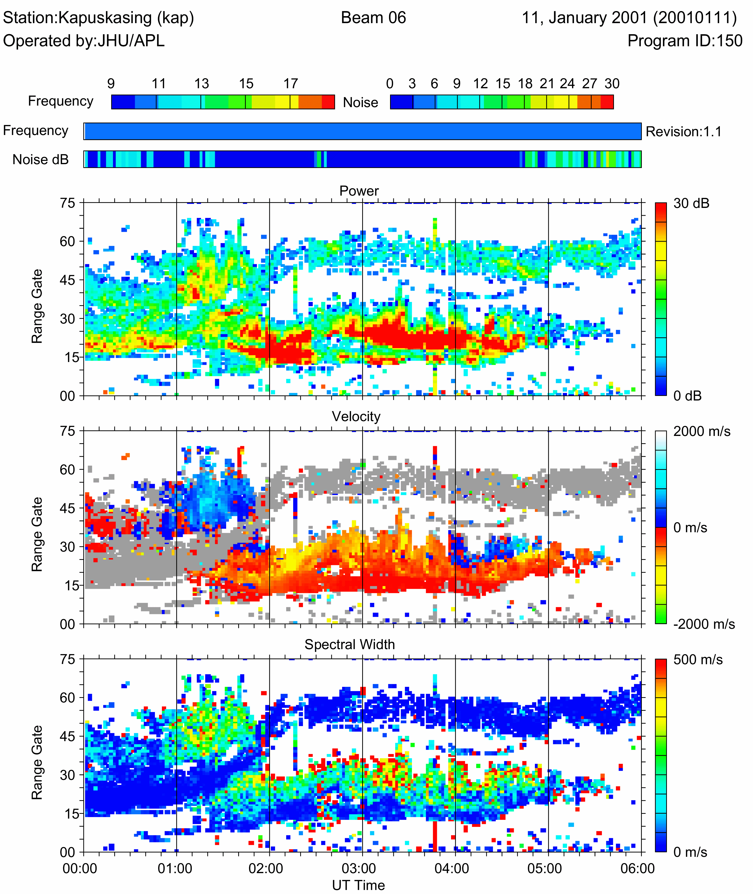
SuperDARN Data: Single-Beam Time-Series
Time
Range
Power
1-1/2 hop
Ground Scatter
Doppler Velocity
1/2 hop
Spectral
Width
Single beam range-time series (Power, Doppler, Spectral Width)

Slide 14
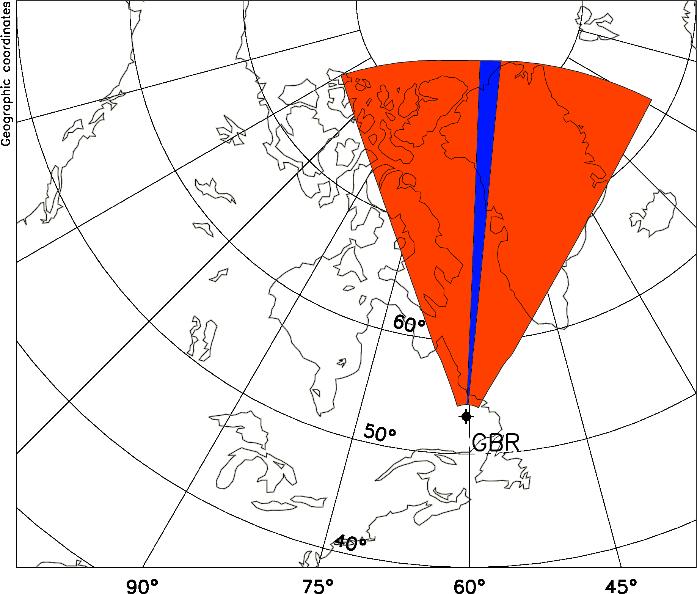
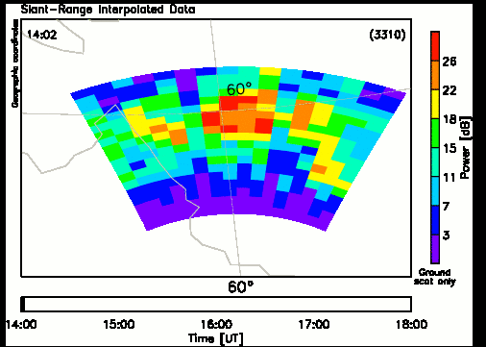
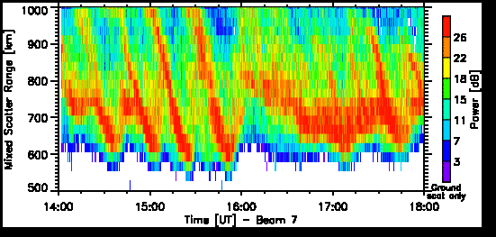
Example of SuperDARN HF Radar Operations: Observing Traveling Ionospheric Disturbances (TIDs) using Groundscatter
1)
2)
Goose Bay Radar (GBR)
19 November 2010
3)
1) Scanning pattern of radar with single beam indicated
2) Movie of b/s power returned over a portion of the field of view
3) Time series of b/s power returned on the single beam
[Frissell et al., 2016]

Slide 15
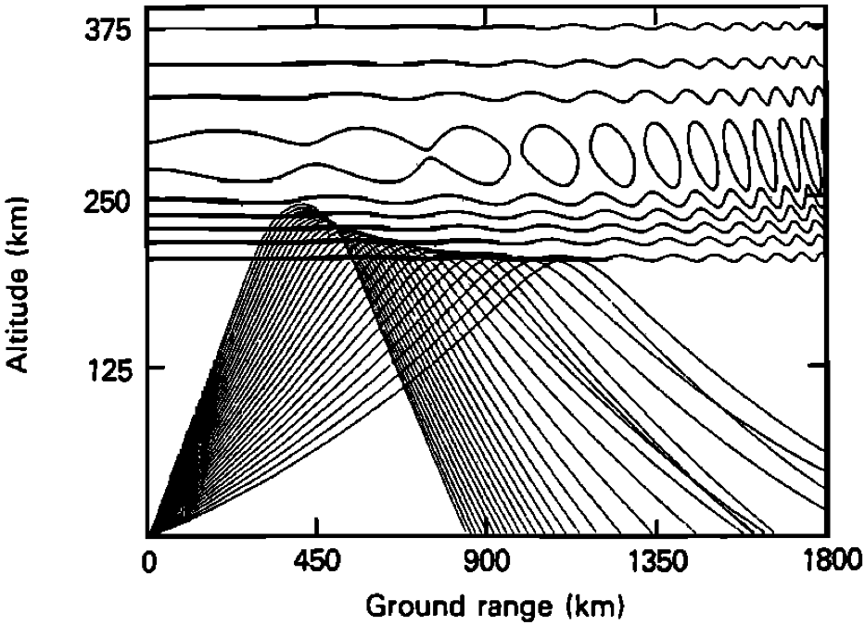
HF Ray Paths during TID / Atmospheric Gravity Wave Event
Atmospheric Gravity Waves
Atmospheric Gravity Wave (AGW) causes moving ionospheric concavities
Concavities focus radar beams, therefore resulting in stronger backscatter at these locations.
[Bristow et al., 1994]
Notes:
Density depletion leads to ray focusing
Ray backscatters off of ground/ocean approximately twice the range between the radar and the ionospheric reflection point.
Apparent wavelengths are approximately twice actual wavelength.
Phase surfaces appear curved because change in distance to reflection point gives larger changes in range at far range gates than at near ones.
Propagation azimuth in radar data is wrong. It needs to be corrected to account for Earth’s curvature and slant range of radar measurement.

Slide 16
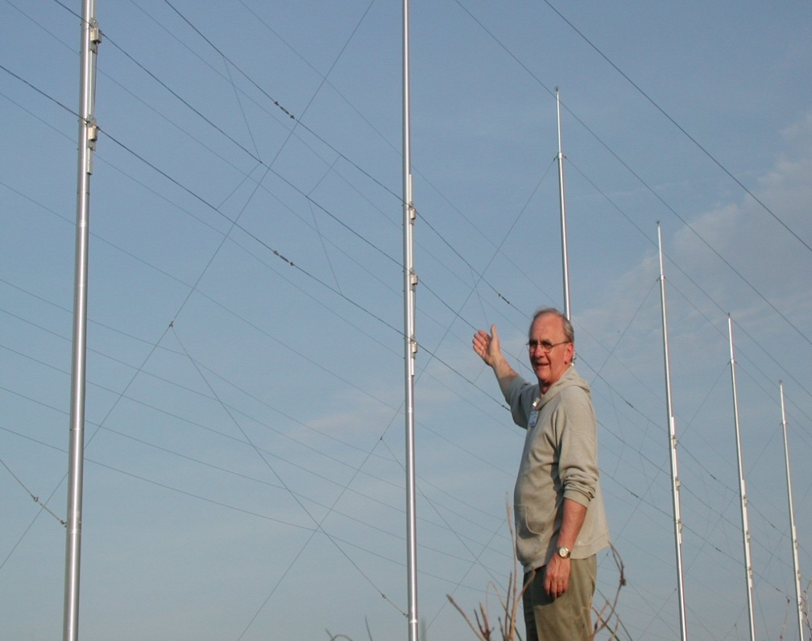
SuperDARN: A Brief History
Ray Greenwald: Founder of SuperDARN
Co-founders (Original PIs): George Sofko (Canada), Dave Walker (South Africa), Tudor Jones (UK), John Dudeney (UK), Jean-Paul Villain (France), Natsuo Sato (Japan)

Slide 17
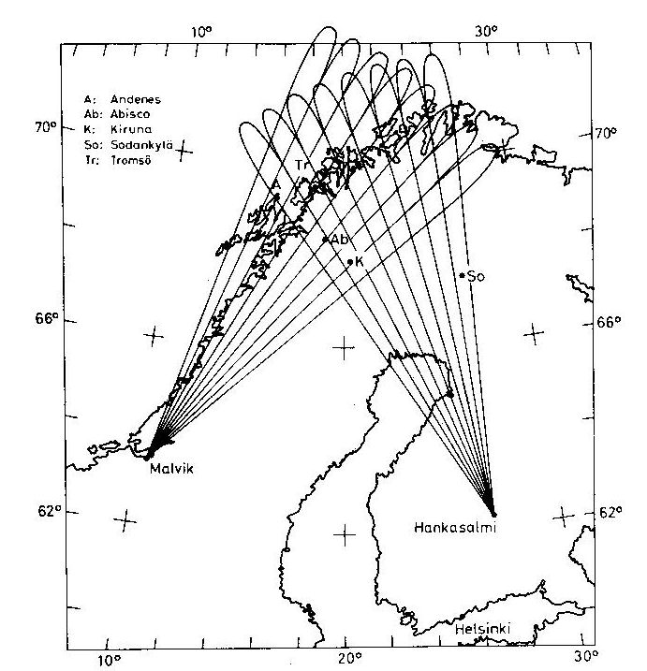
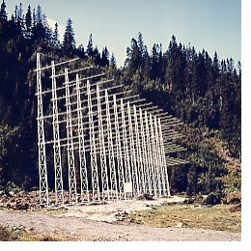
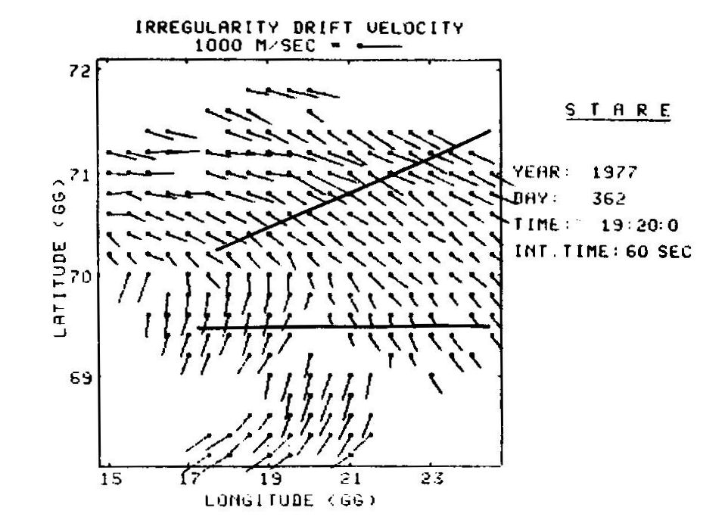
STARE VHF Radar – Precursor to SuperDARN
A bistatic coherent scatter radar built in Scandinavia in the 1970s [Greenwald et al., 1978] and operated at 140 MHz
Generated 2-D velocity vectors by merging E-region line-of-sight velocity measurements
Greenwald, 2021
STARE receiver array
(Malvik, Norway)

Slide 18
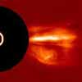
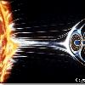
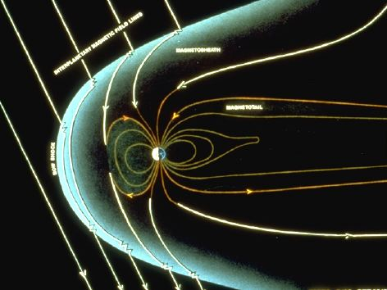
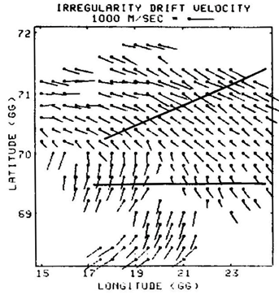
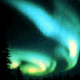
Origins of Visual Aurora and Plasma Motion in the Ionosphere
Solar wind plasma
collides with Earth’s magnetosphere
Causing currents to flow
And high-latitude
effects

Slide 19
Why HF radar?
The magnetic aspect condition limits VHF (30 – 300 MHz) radar to observing FAIs in the E region from a ground-based observatory
With refraction on HF frequencies (3 – 30 MHz) it becomes possible to observe FAIs in the F region
Refraction also extends the coverage to enormous distance, hence giving rise to the Over the Horizon Radar (OTH-R) capability
The Doppler shift from E region FAIs was found to not be a reliable measure of E x B plasma drift velocity
The Doppler shift from F region FAIs is dominated by the motion of the background plasma (in the plane perpendicular to B) – more reliable measure of E x B plasma drift velocity

Slide 20
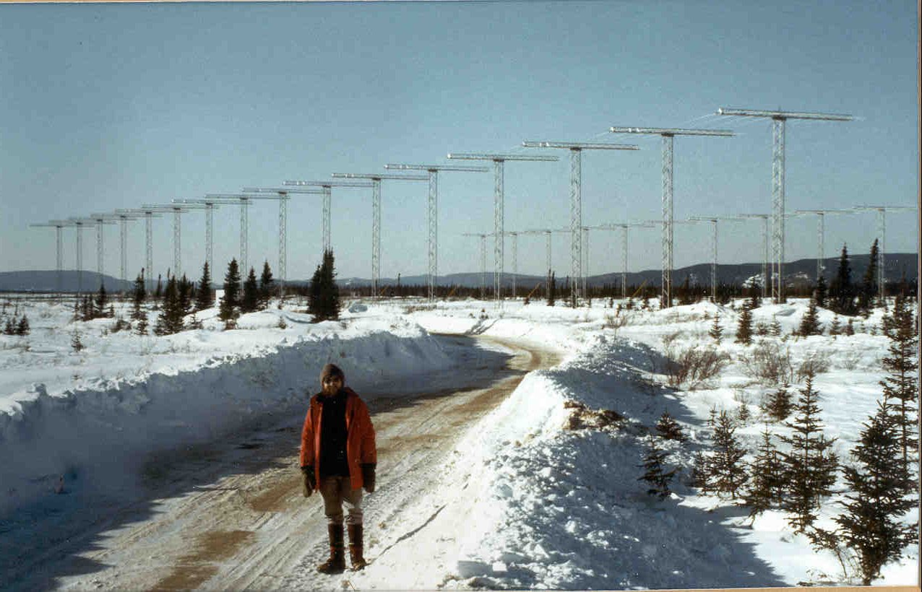
First Radar: Goose Bay, Labrador (1983)
In photo: John Dudeney, British Antarctic Survey (1988?)

Slide 21
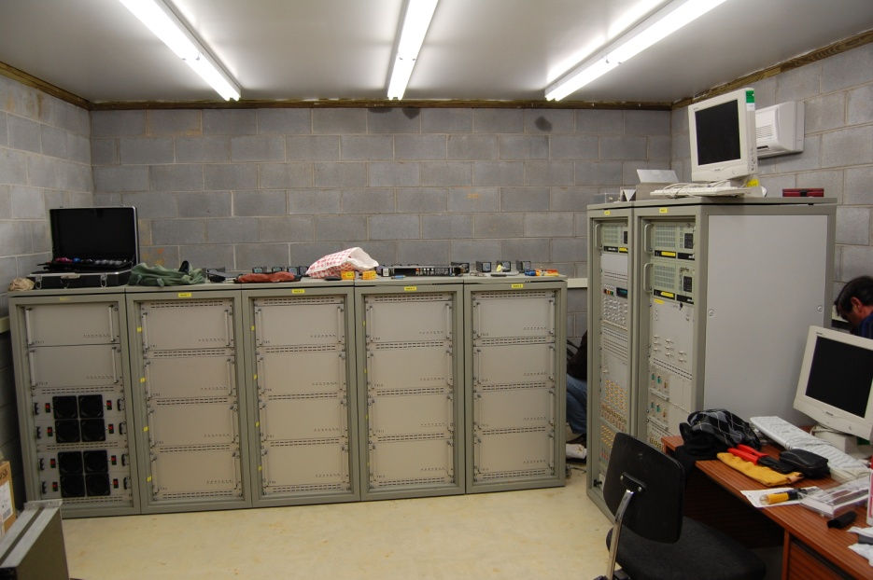
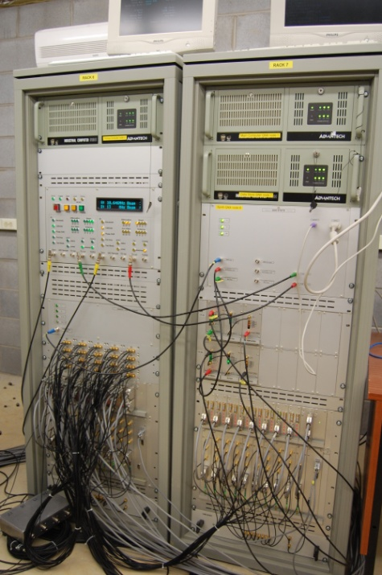
SuperDARN Radar Electronics (2000)
Computers
Receiver
Transmitters
Phasing Matrix
Electronics designed by Leicester University (UK) at Hokkaido (?)

Slide 22
SuperDARN: What Is It?
The Super Dual Auroral Radar Network (SuperDARN) is an international network of high-frequency (HF) space weather radars.
Principle backscatter targets are plasma irregularities with decameter spatial scales.
The plasma irregularities are moved around by electric fields generated in space.
Each SuperDARN radar has the following characteristics:
  Operates continuously at frequencies between 9 - 18 MHz
  Transmits ~10 kW of peak power
  Uses phased array steering to look in 16 or more beam directions
  Uses multi-pulse sequences to simultaneously determine range & Doppler velocity
  Has typical range and time resolutions of 45 km and 1-2 minutes
All SuperDARN radars produce identical data products that are routinely combined to produce hemispheric space weather maps of ionosphere plasma motion.

Slide 23
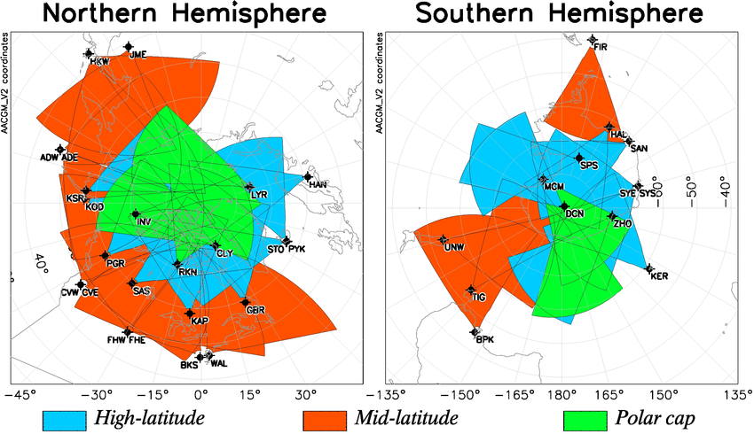
Fields of View of the SuperDARN radars (2020)

Slide 24
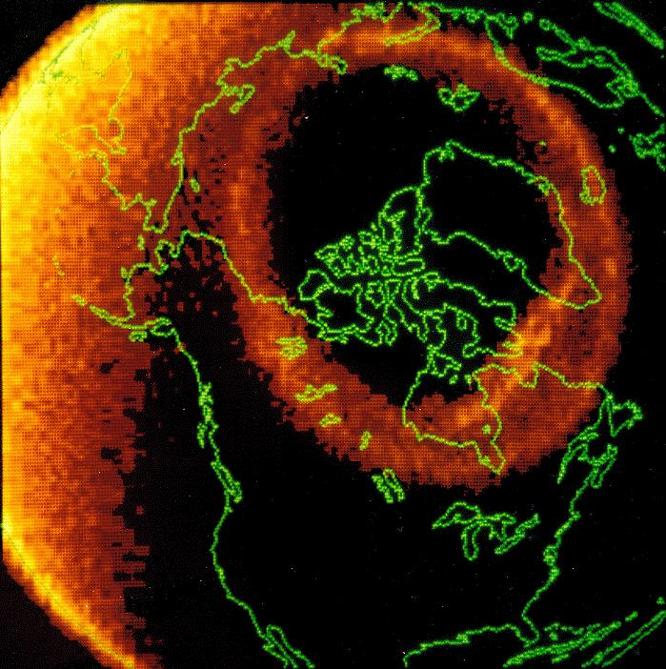
Regions of the Ionosphere
The radars are organized into three latitudinal tiers
Image of auroral oval from the Dynamics Explorer 1 satellite on Nov. 8, 1981
Polar Cap
High-Latitude (Auroral)
Region
- first radar chain built
Mid-Latitude (Subauroral) Region

Slide 25
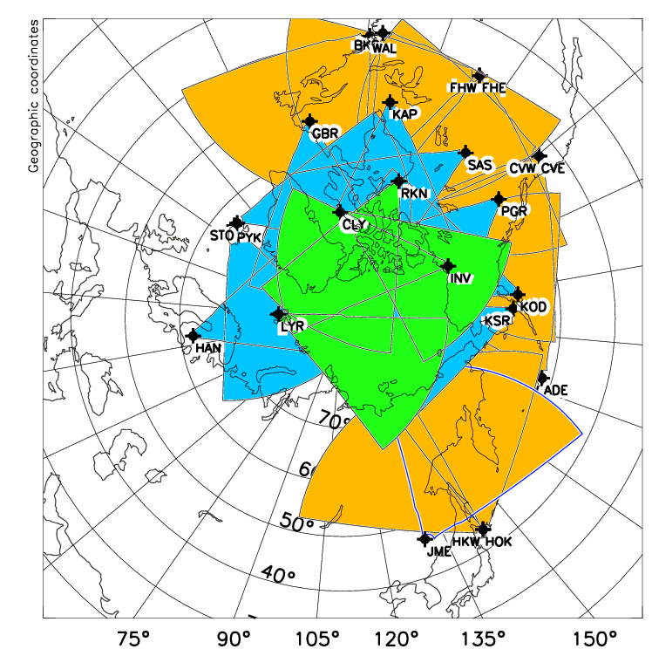
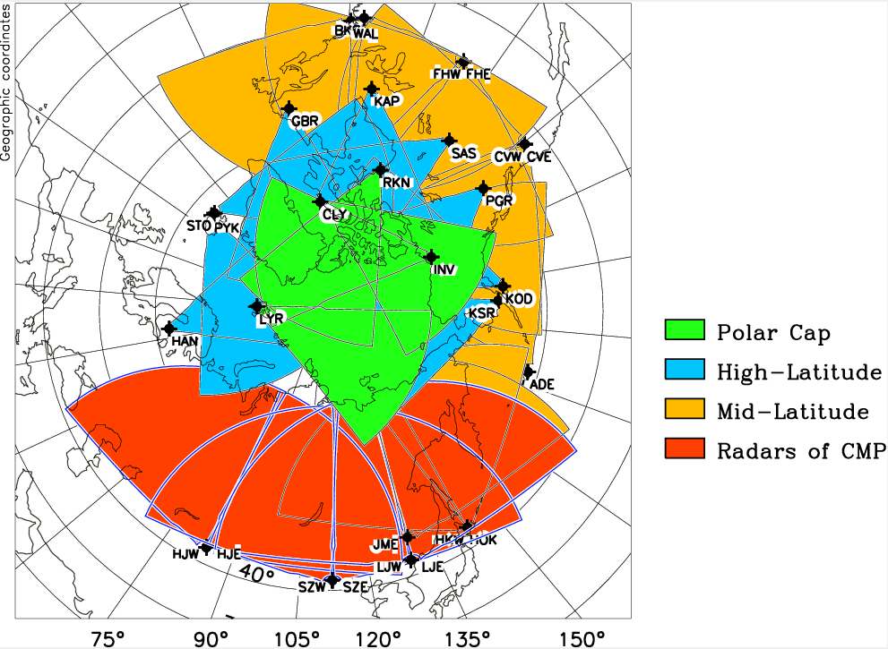
1
Introduction-SuperDARN Coverage
Before 2024
From 2024
Slide credit: J. Zhang (SuperDARN Workshop 2024)
Notes:
This figure show the coverage of SuperDARN in Northern hemisphere before 2024, (forgot to add ICE and ICW radar) and after 2024, the coverage of SuperDARN in Northern hemisphere will be this. It extends about 9 local time in longitude, covering the mid to high latitudes of the entire Asia region above 40◦, which extend the coverage of SuperDARN coverage greatly.

Slide 26
SuperDARN – An International Collaboration
Founded in 1991, first purpose-built radars constructed in 1993 (Kapuskasing, Saskatoon)
The networks of radars in the northern and southern hemispheres are operated by about institutions supported by the funding agencies of 10 countries
Groups join the collaboration by building an HF radar and contributing to the data flow
The key requirements are to share data and operate the radars according to a schedule and in compatible modes as stipulated in the Principal Investigator’s Agreement
Many management tasks are handled by Working Groups (including software development)
Radars age out and new radars come online

Slide 27
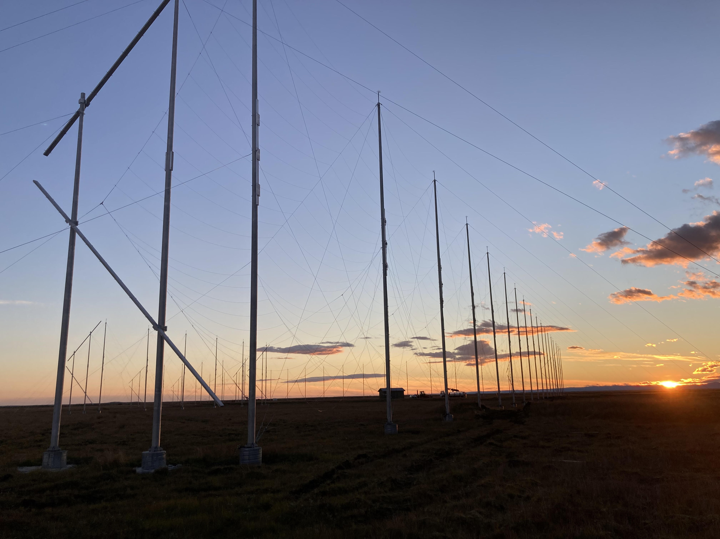
Antenna arrays of the newly built SuperDARN radars in Iceland (2023)
Replaces two earlier radars
Credit: Simon G. Shepherd (PI)

Slide 28
SuperDARN Institutions (Date of first radar)
Johns Hopkins University Applied Physics Laboratory, USA (1983)
British Antarctic Survey, UK (1988)
University of Saskatchewan, Canada (1993)
National Center for Scientific Research, France (1994)
National Institute for Polar Research, Japan (1995)
University of Leicester, UK (1995)
South African National Space Agency, South Africa (1997)
University of Alaska, USA (2000)
National Institute of Information and Communications Technology, Japan (2001)
La Trobe University, Australia (2001)
Nagoya University, Japan (2006)
Virginia Tech, USA (2008)
Dartmouth College, USA (2010)
Polar Research Institute, China (2011)
Institute for Space Astrophysics and Planetology, Italy (2012)
National Space Science Center, China (2018)

Slide 29
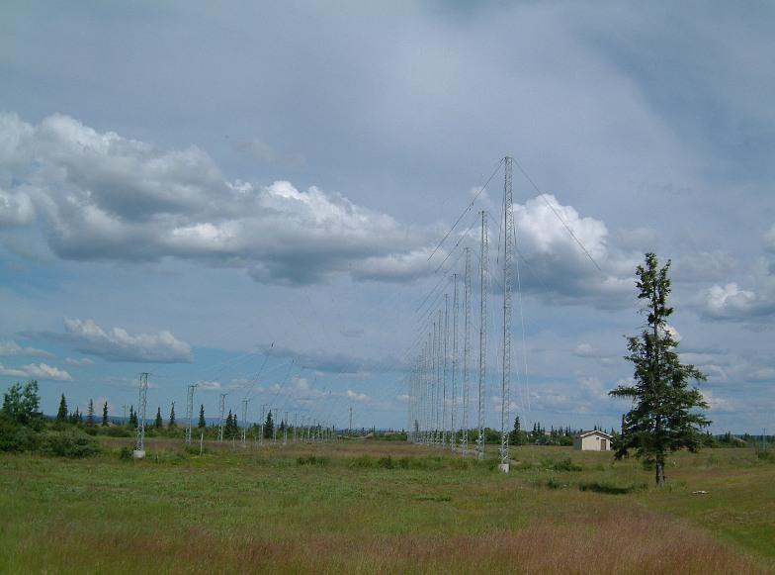
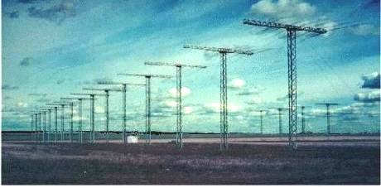
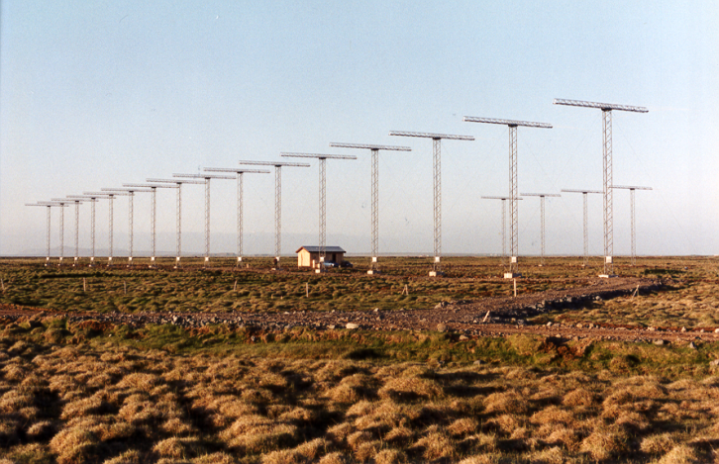
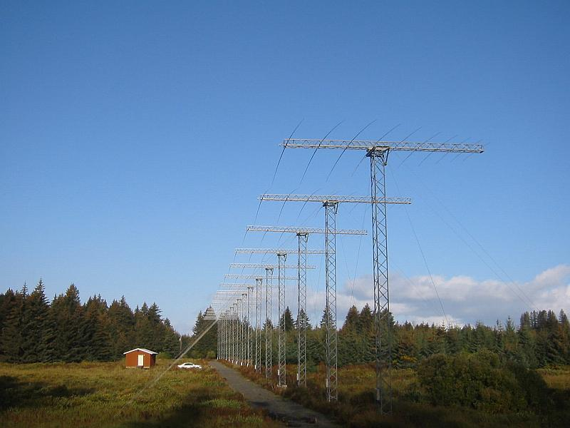
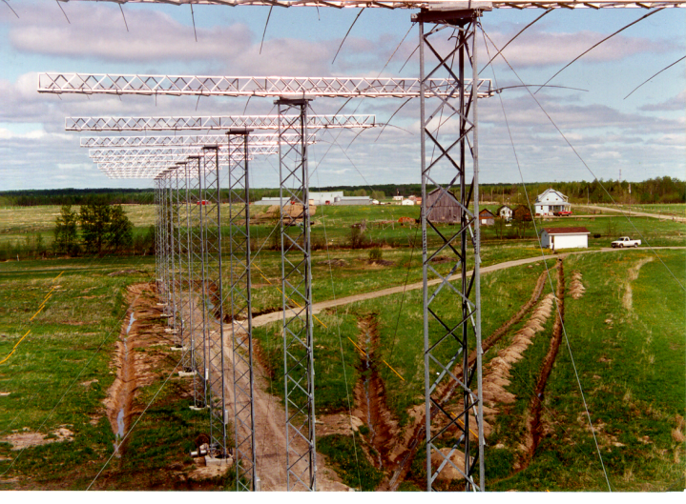
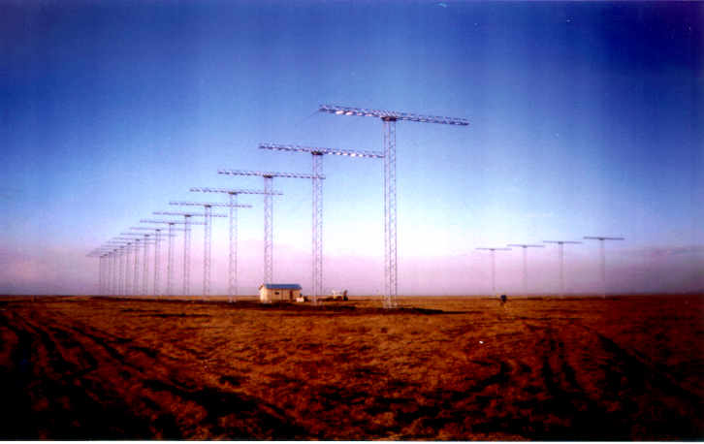
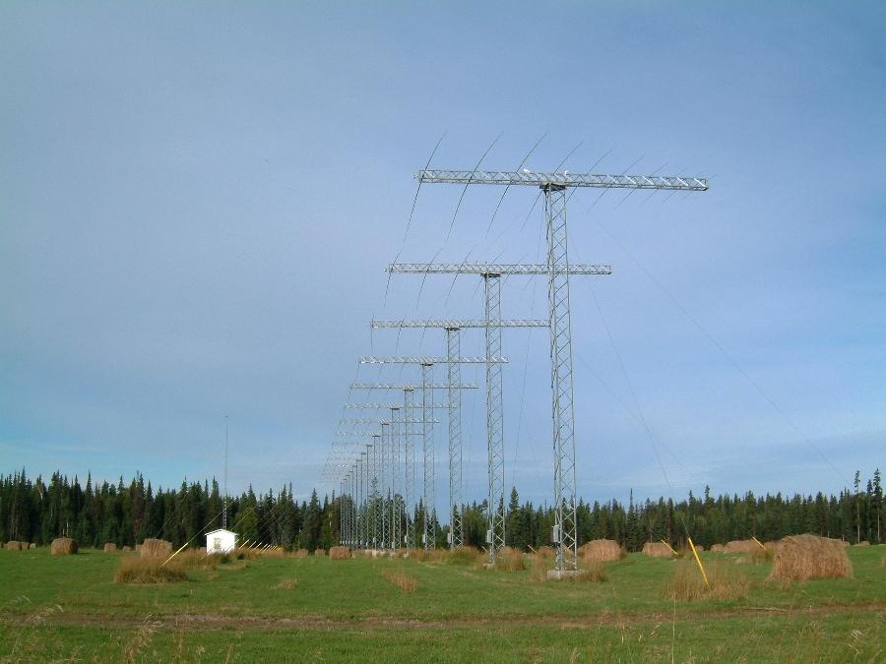

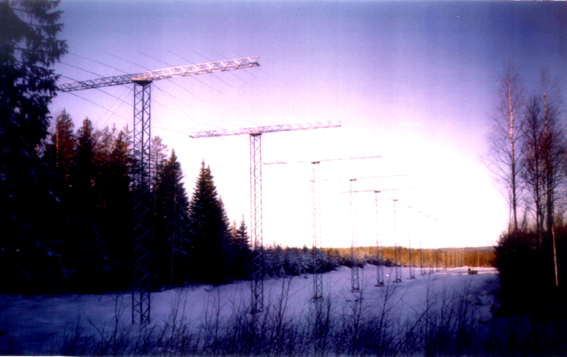
SuperDARN: Some Northern Hemisphere Radars
King Salmon, AK
Saskatoon, Saskatchewan
Stokkseyri, Iceland
Kodiak, AK
Kapuskasing, Ontario
Pykkvibaer, Iceland
Goose Bay, Labrador
Prince George, B.C.
Hankasalmi, Finland

Slide 30
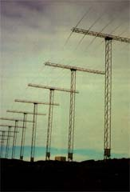
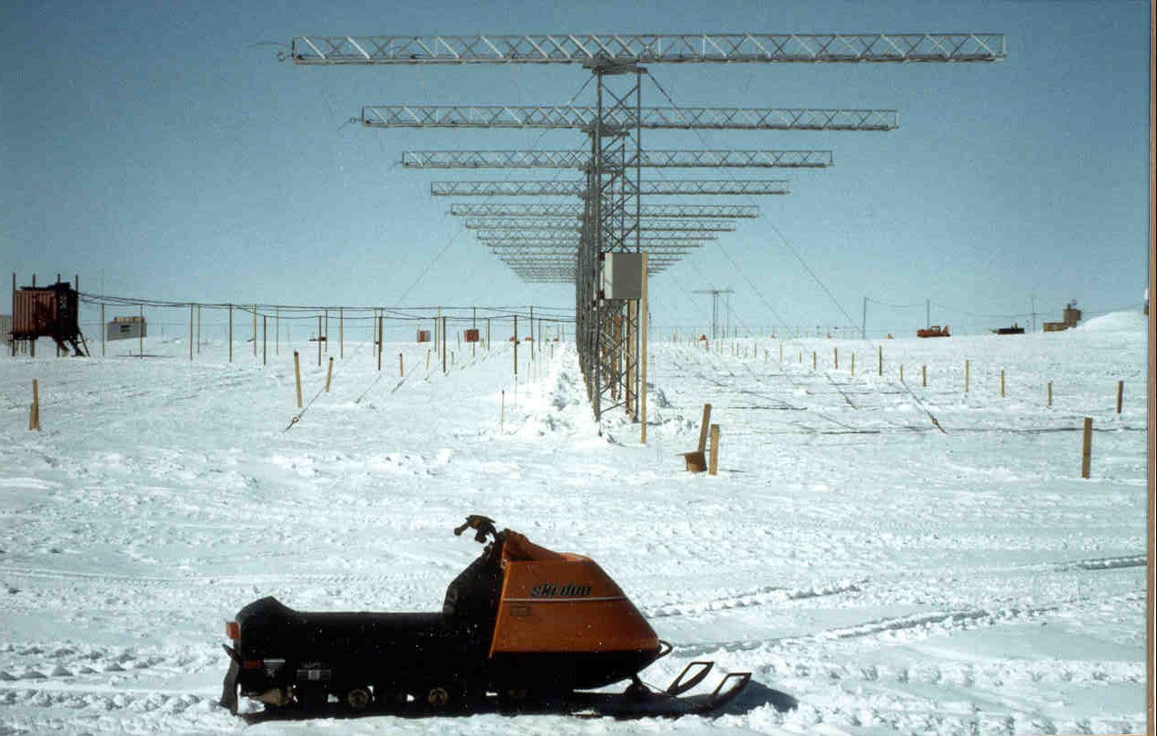
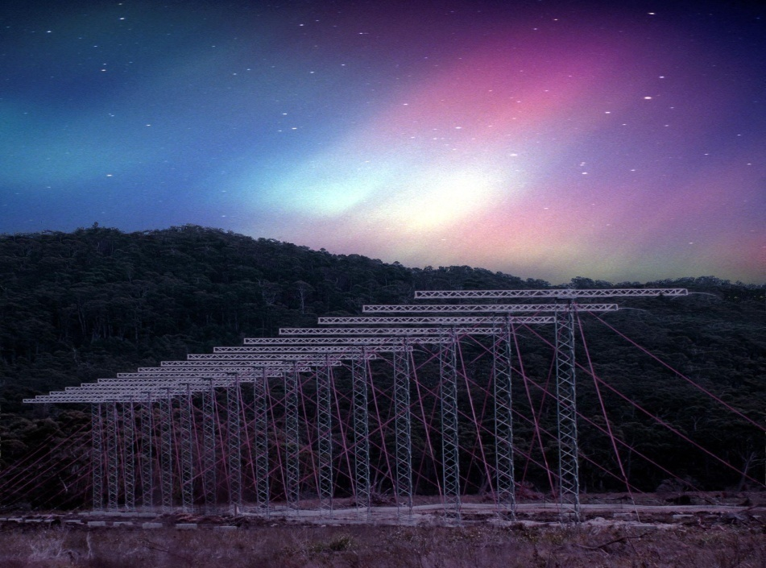
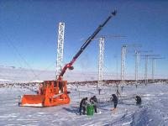
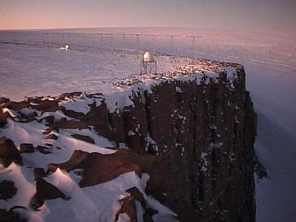
SuperDARN: Some Southern Hemisphere Radars
Bruny Is., Tasmania
Halley, Antarctica
Syowa, Antarctica
SANAE, Antarctica
SANAE, Antarctica

Slide 31
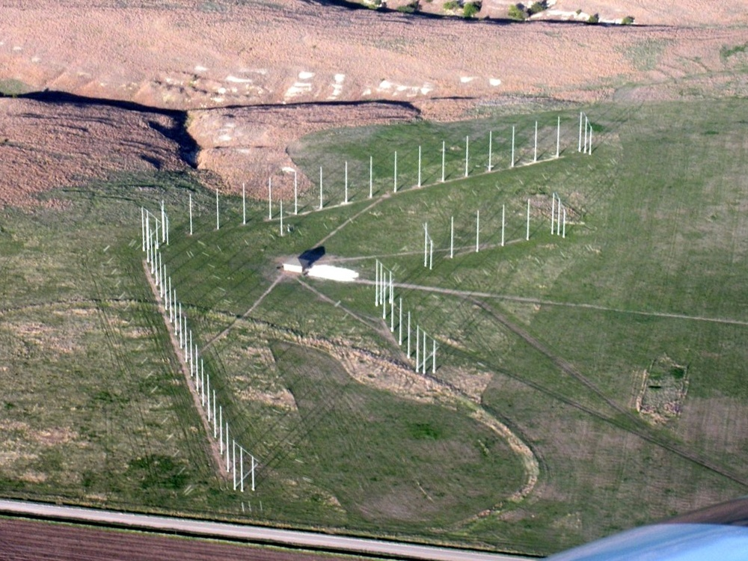
First two-radar SuperDARN site - Hays, Kansas
Aerial photo: one radar is oriented towards the NE, the other towards the NW

Slide 32
High-Latitude SuperDARN: Science Highlights

Slide 33
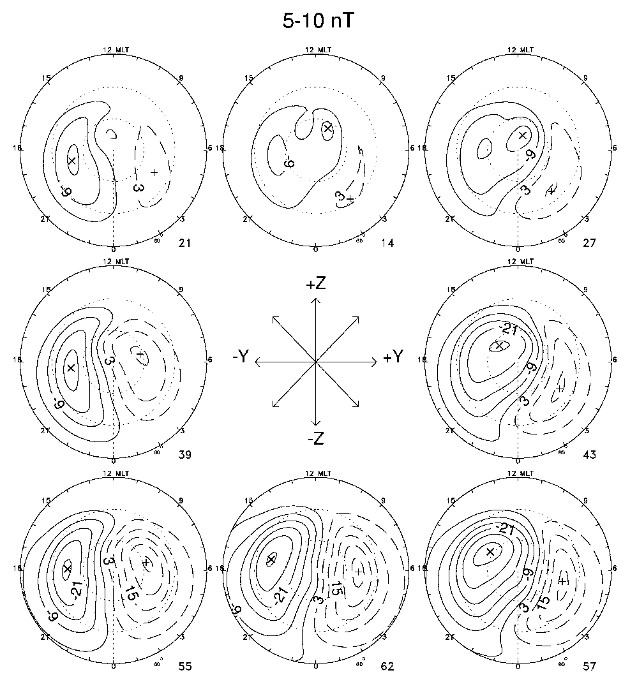
High-Latitude Science: Ionospheric Plasma Convection
SuperDARN measurements have been used to derive several statistical models of ionospheric plasma convection.
This figure shows how the pattern of convection is controlled by the orientation of the Interplanetary Magnetic Field (IMF).
The north-south (Bz) component controls the overall strength of convection while the east-west (By) component controls dawn-dusk asymmetry in the patterns.
Ruohoniemi and Greenwald [2005]

Slide 34
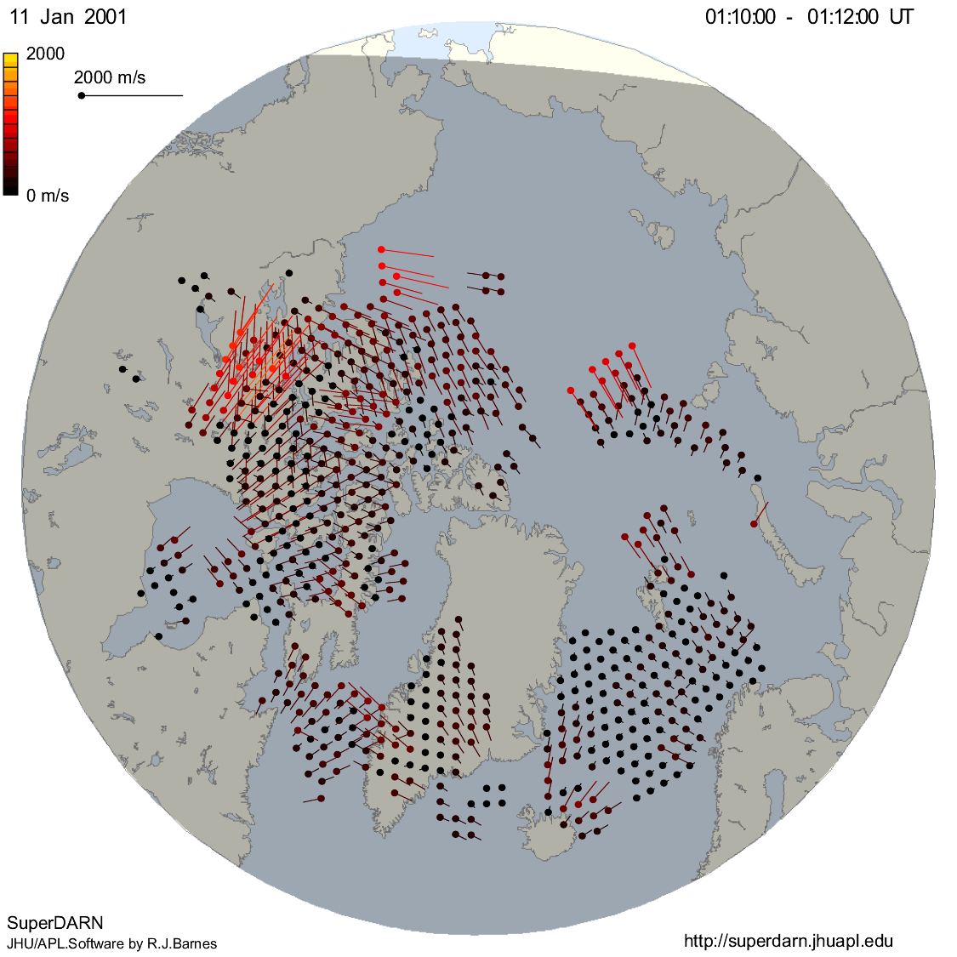
SuperDARN Data: Multi-Radar Doppler Map
January 11, 2001 01:10:00 – 01:11:47 UT
All Northern Hemisphere Radars, 2-minutes of Line-of-Sight Doppler Data

Slide 35
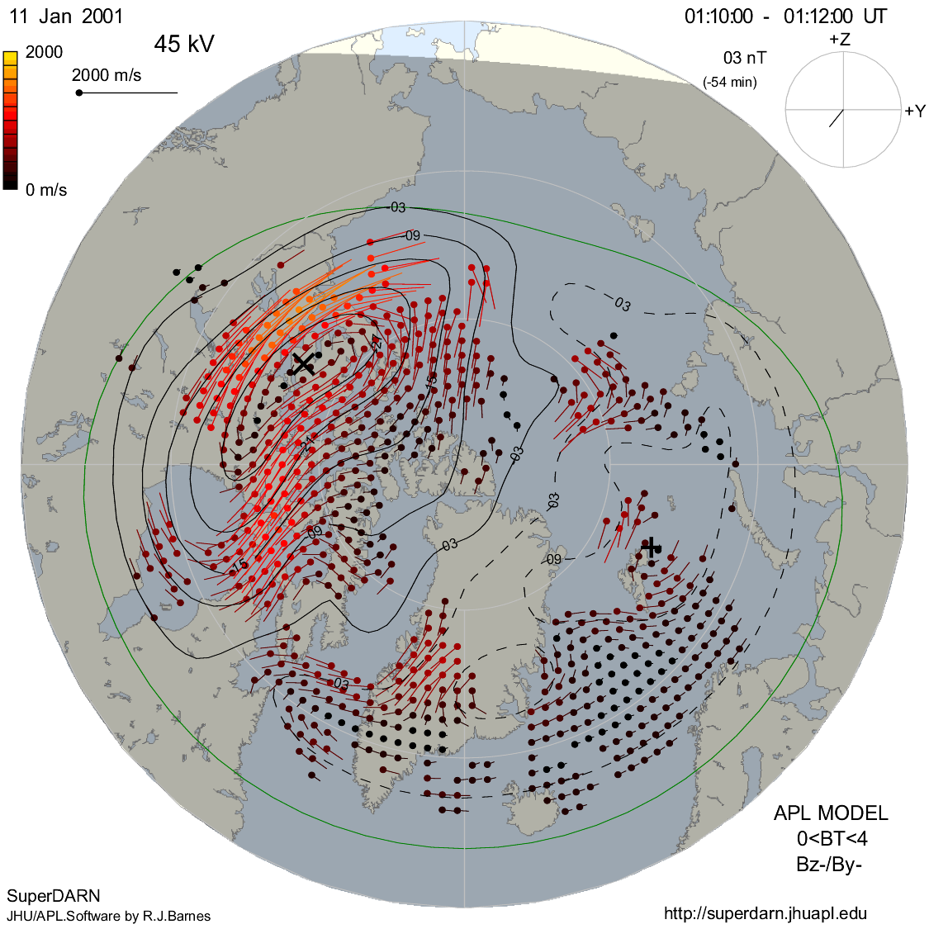
SuperDARN Data: Multi-Radar Convection Map
January 11, 2001 01:10:00 – 01:11:47 UT
Ruohoniemi and Baker [1998]
Shepherd and Ruohoniemi [2000]
Two-Dimensional Least-Squares Spherical Harmonic Fit to the Data
All Northern Hemisphere Radars, Fitted Ionospheric Velocity Vectors

Slide 36
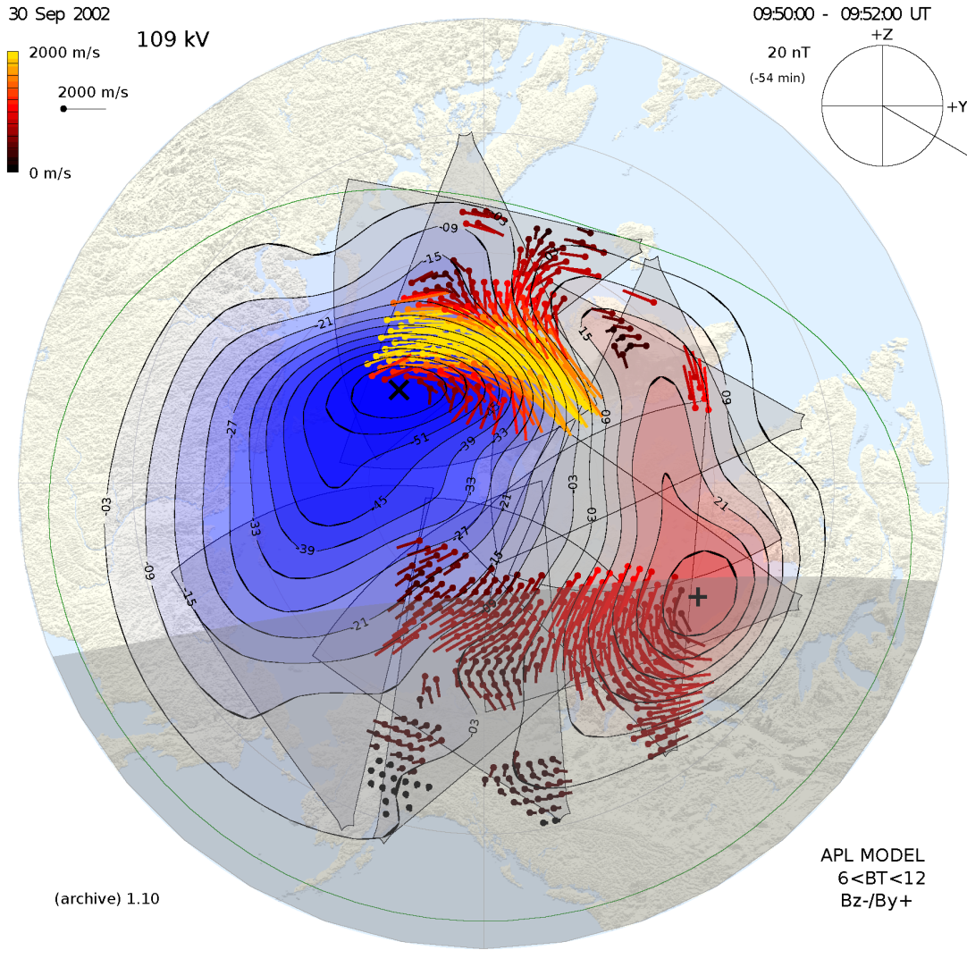

SuperDARN Data: North-South Convection Maps
Instantaneous maps of plasma convection show asymmetry due to IMF By effect between the conjugate regions

Slide 37

High-Latitude Science: Convection Changes
SuperDARN can image the global pattern of ionospheric plasma convection on 1-2 minute timescales
This sequence of maps at 6-min step shows the response of the high-latitude convection pattern in the northern hemisphere to the arrival of a Coronal Mass Ejection (CME).
Ruohoniemi et al., [2001]

Slide 38

High-Latitude Science: Convection Changes
This sequence of figures at 6-min step shows how the convection pattern reconfigures when the IMF rotates from northward (Bz+) to southward (Bz-).
Reverse convection in the noon sector gives way rapidly to robust two-cell convection.
Chisham et al., [2007]

Slide 39

High-Latitude Science: Auroral Activity
Auroral substorms and pseudo-breakups are associated with Bursty Bulk Flows (BBFs) measured by spacecraft in the tail of the magnetosphere.
This figures shows the ionospheric signature of a BBF to be an enhancement in the strength of flows near the midnight convection reversal boundary just poleward of an auroral intensification measured by the Far Ultra-Violet (FUV) instrument aboard the NASA IMAGE spacecraft.
Grocott et al., [2004]

Slide 40

High-Latitude Science: Pulsed Dayside Flows
Many studies have used SuperDARN data in conjunction with spacecraft measurements to improve our understanding of solar wind – magnetosphere coupling processes
Here, pulsed noon sector flows measured by SuperDARN radars in both hemispheres are identified as ionospheric signatures of magnetic Flux Transfer Events (FTEs) measured by spacecraft at the dayside magnetopause
Wild et al., [2003]

Slide 41


High-Latitude Science: ULF Pulsations
Ponomarenko et al., [2005]
Ultra-Low Frequency (ULF) pulsations are signatures of magnetohydrodynamic (MHD) waves that provide important information about the flow of energy and momentum in the coupled magnetosphere-ionosphere system.
ULF waves appear in SuperDARN data as quasiperiodic fluctuations in the Doppler velocity and/or the backscattered power.
During this event, the energy source for the ULF wave activity was determined to be ion-cyclotron waves detected in the upstream solar wind.

Slide 42
Mid-Latitude SuperDARN: Science Highlights

Slide 43


Mid-Latitude SuperDARN: The Motivation
Kp = 2
Kp = 7
The first array of SuperDARN radars was sited near 60º magnetic latitude because .the auroral oval tends to stay poleward of this latitude “most of the time”
During magnetic storms the rate of SuperDARN data capture is reduced because the auroral oval and associated convection moves equatorward of the radars

Slide 44


Mid-Latitude SuperDARN: Statistical Impact
Without Wallops
With Wallops
Φ=61kV
Φ=76kV
Disturbed Conditions (Kp > 3):
  Two-cell convection pattern extends equatorward of 60º.
  Average cross polar potential increased by 25%.
Quiet Conditions (Kp < 3):
  Two-cell convection pattern at high latitudes fed from lower latitudes on evening side and drained on the morning side. Westward across midnight.
Φ=40kV
Φ=36kV
0
500
1000
1500
2000
Baker et al., [2007]
Number of Measurements

Slide 45



Mid-Latitude Science: SAPS
IMF Bx
IMF By
IMF Bz
Beam-4
SAPS Speed
August 6th, 2005
Oksavik et al., [2006]
The Sub Auroral Polarization Stream (SAPS) is a thin channel of high speed flow that forms just equatorward of the auroral oval during geomagnetic storms.
Mid-latitude SuperDARN radars provided the first opportunities to monitor the dynamics of SAPS with high temporal resolution and broad spatial coverage.

Slide 46

Mid-Latitude Science: SAPS
9th April 2011
Clausen et al., 2012
Mid-latitude radars are able to capture the longitudinal structure of SAPS features and monitor its dynamics continuously. This is a SAPS event on April 9th 2011.

Slide 47


SAPS: Large-Scale Structure & Dynamics
9th April, 2011
SAPS Vector Time-Series
CVE-CVW
FHE-FHW
BKS-WAL
Clausen et al., [2012]
GPS Total Electron Content (TEC) measurements confirm the high velocity SAPS flows are located inside the mid-latitude low conductance trough (LEFT).
Comparison of vector time-series produced for each radar pair shows coherence in SAPS dynamics and a quasi-exponential MLT-dependence of flow speed (RIGHT).

Slide 48

Mid-Latitude Science: Plasma Structuring
Thomas et al., [2013]
By combining SuperDARN convection patterns with maps of GPS Total Electron Content (TEC) it’s possible to monitor how plasma structures form and evolve.
Here, the convection pattern carves out a distinct polar Tongue of Ionization (TOI).

Slide 49



Mid-Latitude Science: TOI & Fossil SED
First direct observations of the evolution of Storm-Enhanced Density (SED) into a Tongue of Ionization (TOI) using mid-latitude SuperDARN and GPS-TEC data
19:00 UT
23:00 UT
SED
FOSSIL SED
TOI
26 September, 2011
Thomas et al., [2013]
Storm Main Phase
Southward IMF
Convection Expands Equatorward
Tongue of Ionization (TOI) Forms
Storm Recovery Phase
Northward IMF
Convection Retreats Poleward
“Fossil” SED Feature Remains

Slide 50

Mid-Latitude Science: Instability Processes
Greenwald et al., [2006]
At high latitudes, ion convection speeds are high and the Gradient-Drift Instability (GDI) is generally thought to produce most irregularities seen by SuperDARN.
At middle latitudes, the convection speeds are much lower and it is still somewhat an open question what instability produces most mid-latitude irregularities.
This study found intensification of irregularity backscatter seen by the WAL radar coincided with a reversal of temperature gradient seen by the Millstone Hill ISR.
The Temperature-Gradient Instability (TGI) is a viable irregularity source.

Slide 51

Mid-Latitude Science: Earthquake TID Signatures
Ogawa et al., 2012
SuperDARN radars have been used to monitor Traveling Ionospheric Disturbances (TIDs) launched by earthquakes and other seismic events
This figure shows northward propagating TIDs measured by the HOK radar after the 9.0 magnitude earthquake that produced the Fukushima Daichi nuclear disaster

Slide 52

Solar Flare Effects – Short Wave Fadeout
Observations with the Blackstone SuperDARN radar of the impact of a solar flare – suppression of daytime HF groundscatter and a sudden frequency deviation or ‘Doppler flash’
Chakraborty et al., 2018

Slide 53


Suprising Capability – Measuring Winds in the Mesosphere
Hall et al., [1997]
Hall et al., [1997] reported a new type of “grainy near-range echoes” or GNREs that showed diurnal variations consistent with backscatter from meteor trails.
The Doppler shift of the GNREs provides information about neutral winds in the mesosphere and lower thermosphere at ~94 km altitude, seen in near range gates
Studies have used these mesospheric wind measurements to monitor atmospheric tides, planetary waves and other large-scale atmospheric disturbances.

Slide 54


Suprising Capability – Mapping the Extent of Sea Ice
Comparison of sea ice cover and HF groundscatter
From: Evan Thomas
Furthest extent of sea ice cover during month of October 2000 (National Snow and Ice Data Center, Boulder, CO).
Ground scatter occurrence rate observed by the radar at Goose Bay during daytime over the month of October 2000.

Slide 55
Summary of High- and Mid-latitude Science Highlights
First generation SuperDARN radars were constructed at auroral latitudes to provide information about how the ionosphere couples to the magnetosphere & solar wind:
  Control of ionospheric convection by the Interplanetary Magnetic Field (IMF)
  Ionospheric signatures of Flux Transfer Events (FTEs) at the magnetopause
  Ultra-Low Frequency (ULF) pulsations & magnetohydrodynamic (MHD) waves
  Ionospheric irregularity formation during heating experiments
  Traveling Ionospheric Disturbances (TIDs), atmospheric tides & planetary waves
Second generation radars at middle latitudes have provided new information about:
  Equatorward expansion of ionospheric convection during Geomagnetic Storms
  Large-scale dynamics of the Sub-Auroral Polarization Stream (SAPS)
  Tongue of Ionization (TOI) evolution from Storm-Enhanced Density (SED)
  Viable instability mechanisms for producing subauroral irregularities
  Storm-time ion-neutral coupling
  Earthquake TID signatures

Slide 56
A Tutorial for SuperDARN – References (1/2)
Baker, J. B. H., R. A. Greenwald, J. M. Ruohoniemi, K. Oksavik, J. W. Gjerloev, L. J. Paxton, and M. R. Hairston (2007), Observations of ionospheric convection from the Wallops SuperDARN radar at middle latitudes, J. Geophys. Res., 112, A01303, doi:10.1029/2006JA011982.
Bristow et al., [1994]: Bristow, W. A., R. A. Greenwald, and J. C. Samson (1994), Identification of high-latitude acoustic gravity wave sources using the Goose Bay HF radar, J. Geophys. Res., 99(A1), 319–331, doi:10.1029/93JA01470.
Chakraborty, S., Ruohoniemi, J. M., Baker, J. B. H., & Nishitani, N. (2018). Characterization of short-wave fadeout seen in daytime SuperDARN ground scatter observations. Radio Science, 53, 472–484. https://doi.org/10.1002/2017RS006488
Chisham, G., Lester, M., Milan, S.E. et al. A decade of the Super Dual Auroral Radar Network (SuperDARN): scientific achievements, new techniques and future directions. Surv Geophys 28, 33–109 (2007). https://doi.org/10.1007/s10712-007-9017-8
Clausen, L. B. N., et al. (2012), Large-scale observations of a subauroral polarization stream by midlatitude SuperDARN radars: Instantaneous longitudinal velocity variations, J. Geophys. Res., 117, A05306, doi:10.1029/2011JA017232.
Frissell, N. A., J. B. H. Baker, J. M. Ruohoniemi, R. A. Greenwald, A. J. Gerrard, E. S. Miller, and M. L. West (2016), Sources and characteristics of medium-scale traveling ionospheric disturbances observed by high-frequency radars in the North American sector, J. Geophys. Res. Space Physics, 121, 3722–3739, doi:10.1002/2015JA022168.
Greenwald, R. A.: History of the Super Dual Auroral Radar Network (SuperDARN)-I: pre-SuperDARN developments in high frequency radar technology for ionospheric research and selected scientific results, Hist. Geo Space. Sci., 12, 77–93, https://doi.org/10.5194/hgss-12-77-2021, 2021.
Grocott, A., Yeoman, T. K., Nakamura, R., Cowley, S. W. H., Frey, H. U., Rème, H., and Klecker, B.: Multi-instrument observations of the ionospheric counterpart of a bursty bulk flow in the near-Earth plasma sheet, Ann. Geophys., 22, 1061–1075, https://doi.org/10.5194/angeo-22-1061-2004, 2004.

Slide 57
A Tutorial for SuperDARN – References (2/2)
Hall, G. E., J. W. MacDougall, D. R. Moorcroft, J.-P. St.-Maurice, A. H. Manson, and C. E. Meek (1997), Super Dual Auroral Radar Network observations of meteor echoes, J. Geophys. Res., 102(A7), 14603–14614, doi:10.1029/97JA00517.
Nishitani, N., Ruohoniemi, J.M., Lester, M. et al. Review of the accomplishments of mid-latitude Super Dual Auroral Radar Network (SuperDARN) HF radars. Prog Earth Planet Sci 6, 27 (2019). https://doi.org/10.1186/s40645-019-0270-5
Oksavik, K., R. A. Greenwald, J. M. Ruohoniemi, M. R. Hairston, L. J. Paxton, J. B. H. Baker, J. W. Gjerloev, and R. J. Barnes (2006), First observations of the temporal/spatial variation of the sub-auroral polarization stream from the SuperDARN Wallops HF radar, Geophys. Res. Lett., 33, L12104, doi:10.1029/2006GL026256.
Ponomarenko, P. V., F. W. Menk, F. W., Waters, C. L., and Sciffer, M. D.: Pc3-4 ULF waves observed by the SuperDARN TIGER radar, Ann. Geophys., 23, 1271–1280, https://doi.org/10.5194/angeo-23-1271-2005, 2005.
Ruohoniemi, J. M., and R. A. Greenwald (2005), Dependencies of high-latitude plasma convection: Consideration of interplanetary magnetic field, seasonal, and universal time factors in statistical patterns, J. Geophys. Res., 110, A09204, doi:10.1029/2004JA010815.
Ruohoniemi, J. M., and K. B. Baker (1998), Large-scale imaging of high-latitude convection with Super Dual Auroral Radar Network HF radar observations, J. Geophys. Res., 103(A9), 20797–20811, doi:10.1029/98JA01288.
Ruohoniemi, J. M., R. J. Barnes, R. A. Greenwald, and S. G. Shepherd (2001), The response of the high-latitude ionosphere to the coronal mass ejection event of April 6, 2000: A practical demonstration of space weather nowcasting with the Super Dual Auroral Radar Network HF radars, J. Geophys. Res., 106, 30,085–30,097.
Sterne, K. T., R. A. Greenwald, J. B. H. Baker, and J. M. Ruohoniemi (2011), Modeling of a twin terminated folded dipole antenna for the Super Dual Auroral Radar Network (SuperDARN), in Radar Conference (RADAR), 2011 IEEE, pp. 934–938, IEEE Xplore, Kansas City, Mo., doi:10.1109/RADAR.2011.5960673.

Slide 58
Space@VT Quick Start Guide (1/2)
A guide has been written by VT summer undergraduate interns to help students completely new to the field
Explains the basics of space weather, what SuperDARN is, how to download and install code, access data, and make plots (with pyDARN)
This is a living document which will be revised this summer by a fresh crop of summer undergrad interns - comments and contributions are welcome!
vt.superdarn.orgn> SuperDARN Resources > Quick Start Guide (broken link? – email request)
Includes a list of resources for students to learn about SuperDARN, e.g., SuperDARN Canada tutorials
SuperDARN and Space Weather Guide
A. Feliberti¹, S. Forsling², T. Golabek¹, P. Pitzer²
SuperDARN Radar Group, Kevin T. Crofton Department of Aerospace and Ocean Engineering, Virginia Tech
SuperDARN Radar Group, Bradley Department of Electrical and Computer Engineering, Virginia Tech

Slide 59


Quick Start Guide (2/2)
Be aware that the guide has not been edited by senior people! It expresses the understanding of the undergraduate students after a summer of training
Where that understanding is faulty or incomplete we see that there is a need to modify our instruction / training
SuperDARN and Space Weather Guide
A. Feliberti¹, S. Forsling², T. Golabek¹, P. Pitzer²
June 23, 2023
Sections:
Introduction to Space Weather
Introduction to SuperDARN
Intro to pyDARN
Installation Guide / Usage / Your First Plot / Examples of Plots
Accessing Data
Further Resources

